Slide 1

NVMe Platform Specs

Slide 2
NVMe Overview
TeraSci Designed all hardware and software
NVMe platform is part of a larger software eco-system
  See TeraSci infrastructure slide for details
NVMe System has been deployed for over 8 years
  NVMe System has tested over 750,000 drives
  NVMe System has been deployed at over 25 WW sites
NVMe System currently supports multiple vendors
  Very Flexible design
    Fast and easy upgrades for process flow and data collection

Slide 3
NVMe Hardware
NVMe System has 2 major styles
  NVMe M.2 – most popular (PCs, Laptops)
  NVMe U.2 - Servers
    Full Functional check
    Scan drive label and tracking info
    Firmware Updates
    Quick disposition for initial failing units
    16 Port Fully asynchronous testing
    Performs extended test functions
    Performs full Data Sanitation (NIST 800-88 compliant)
    Ports support: All NVMe Form Factors with or without trays

Slide 4
NVMe Software
Linux Based test solution
  All test software is 100% developed in house
  Linux is Debian based distribution
We have one “test program” that supports all of our platforms
  A single software package and architecture means
    All platforms share a large amount of common code
    Data structures are common easy to manage
    Database upload / download has a single interface
    TeraSci Parametric tables are text based and easy to understand
    Code updates are faster to deploy and easier to debug

Slide 5
NVMe Test
NVMe test platform
  Operator inspects drive (VMI) and scans the label
    Collects 1 to N scans – at minimum collects drive serial #
  Full functional Check
    Drive Inserted / Power On / No DC shorts
    Read all drive tables
      ID / Cap / Vital / Mode / Log Pages
    Check and update FW if required
    Check SMART
    Short DST and Long DST
    Random Writes and Random Reads
    NIST 800-88 Compliant Erase

Slide 6
NVMe Process
Check for any failures & Fail the drive
For conditional “good” drives
  Build an electronic log
Build a DB record for Pass or Fail drives (upload to the DB)
Inform the operator of the disposition
  Drive Failed (RMA, Scrap)
  Drive Passed
  Drive is on Hold (engineering)
  Operator routes the drive to required disposition

Slide 7
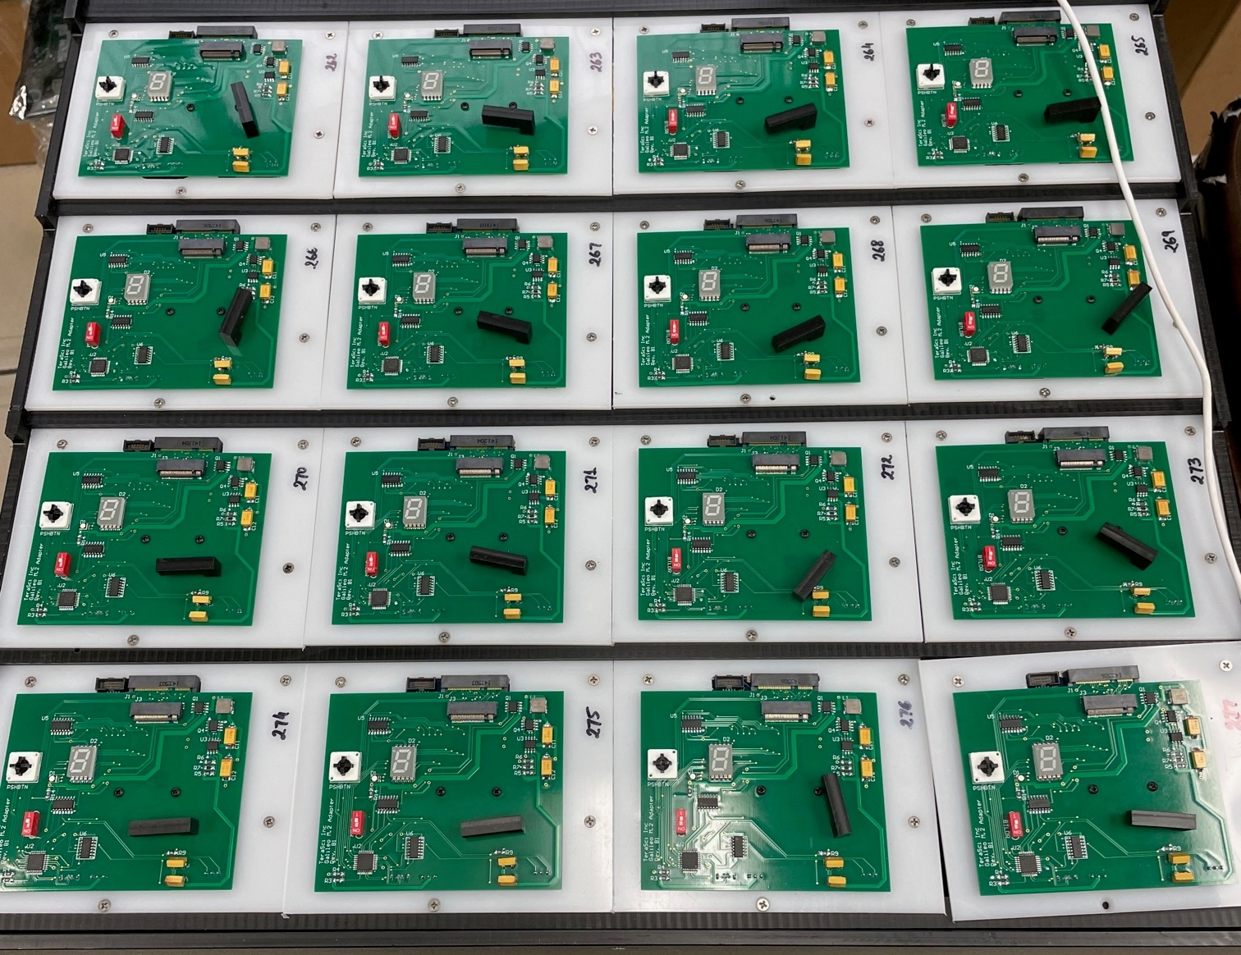
NVMe 16 Port M.2
Picture:

Slide 8
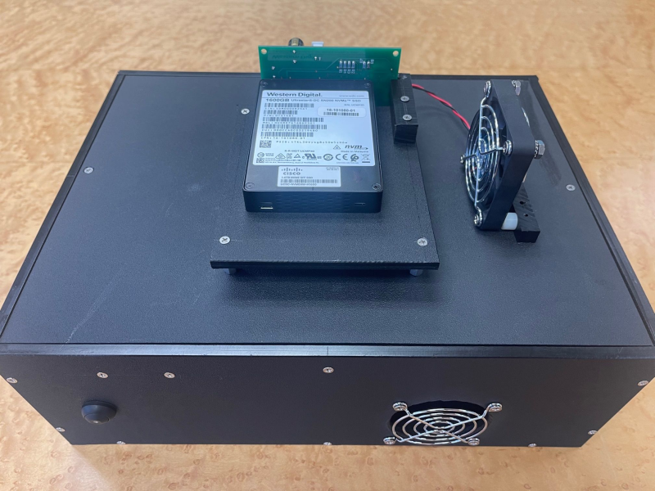
NVMe Single Port U.2
Picture:

Slide 9
NVMe Test
Drives that “pass” Ready Check automatically go to the full test
  Operator starts the selected port
    System launches a new instance of the test program for the selected port
      Configuration flags and the hardware select the NVMe software process
      Each port is running a unique instance of the test program
        With 16 drives 16 test programs are running
          If a bad drive “Locks Up” the software only 1 drive / port is affected
          Each Port is a separate computer

Slide 10
NVMe Test
The software instance for each drive controls the Port Power
  Each port has its own Power FETs and DC monitoring
    Drives are powered OFF when inserted or extracted
    At “Power On” voltage is monitored for DC shorts (safety)
      DC short is an immediate failure
    Each port has its own Health Monitoring file (Consecutive Fails, DC Shorts, Seg Faults, Aborts, etc.)
After Power On the test software check drive status
  If the status is terminal the drive fails immediately
    Many status issues can be resolved and test continues
  When the status is good the process continues

Slide 11
NVMe Test
The test software reads
  All of the drive info > ID / Cap / SM Bus
  All of the TeraSci parametric tables
  The TeraSci test log (built during ready check)
This information configures the test software to proceed
  The drive info defines capacity
  The Test Log defines the script steps
  The TeraSci parametric tables program around drive “quirks”

