Slide 1

SAS Platform Specs

Slide 2
SAS Overview
TeraSci Designed all hardware and software
SAS platform is part of a larger software eco-system
  See TeraSci infrastructure slide for details
SAS System has been deployed for over 15 years
  SAS System has tested over 750,000 drives
  SAS System has been deployed at over 25 WW sites
SAS System currently supports multiple vendors
  Very Flexible design
    Fast and easy upgrades for process flow and data collection

Slide 3
SAS Hardware
SAS System has 2 major components
  SAS Ready Check (RC)
    Preliminary Functional check
    Scan drive label and tracking info
    Firmware Updates
    Quick disposition for initial failing units
  SAS Test Rack
    16 Port Fully asynchronous testing
    Performs extended test functions
    Performs full Data Sanitation
    Ports support: All SAS Form Factors with or without trays

Slide 4
SAS Software
Linux Based test solution
  All test software is 100% developed in house
  Linux is Debian based distribution
We have one “test program” that supports all of our platforms
  A single software package and architecture means
    All platforms share a large amount of common code
    Data structures are common easy to manage
    Database upload / download has a single interface
    TeraSci Parametric tables are text based and easy to understand
    Code updates are faster to deploy and easier to debug

Slide 5
SAS Ready Check
2 port SAS test platform
  All drives enter the SAS process via Ready Check
  Operator inspects drive (VMI) and scans the label
    Collects 1 to N scans – at minimum collects drive serial #
  Initial functional Check
    Drive Inserted / Power On / No DC shorts
    Read all drive tables
      ID / Cap / Vital / Mode / Log Pages
    Check and update FW if required
    Reset Mode pages to saved vales (optional)
    Set Mode pages to customer required values (optional)

Slide 6
SAS Ready Check
Check for any failures & Fail the drive
For conditional “good” drives
  Build an electronic traveler and save to the drive
Build a DB record for Pass or Fail drives (upload to the DB)
Inform the operator of the disposition
  Drive Failed
  Drive is READY for the long test
  Drive is on Hold (engineering)
Operator extracts the drive from RC station
  Operator routes the drive to required disposition

Slide 7
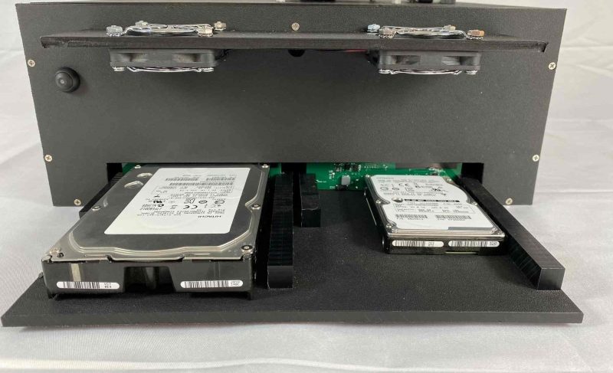
Ready Check
Picture of SAS RC station

Slide 8
SAS 16 Port Long Test
Drives that “pass” Ready Check go to the test rack
  Operator selects an open test port and inserts the drive
    Operator starts the selected port
      System launches a new instance of the test program for the selected port
        Configuration flags and the hardware select the SAS software process
        Each port is running a unique instance of the test program
          With 16 drives 16 test programs are running
            If a bad drive “Locks Up” the software only 1 drive is affected
    Ready Check has eliminated 90% of the troublesome drives
        Port efficiency is improved
          Drives that reach the long test have a higher probability of Passing

Slide 9
SAS 16 Port Long Test
The software instance for each drive controls the Port Power
  Each port has its own Power FETs and DC monitoring
    Drives are powered OFF when inserted or extracted
    At “Power On” voltage is monitored for DC shorts (safety)
      DC short is an immediate failure
    Each port has its own Health Monitoring file
After Power On the test software check drive status
  If the status is terminal the drive fails immediately
    Many status issues can be resolved and test continues
  When the status is good the process continues

Slide 10
SAS 16 Port Long Test
The test software reads
  All of the drive info > ID / Cap / Vital / Mode / Logs
  All of the TeraSci parametric tables
  The TeraSci test traveler (built at RC)
This information configures the test software to proceed
  The drive info defines capacity and HDD or SSD type
  The Test Traveler defines the script steps (HDD or SSD dependent)
  The TeraSci parametric tables program around drive “quirks”

Slide 11
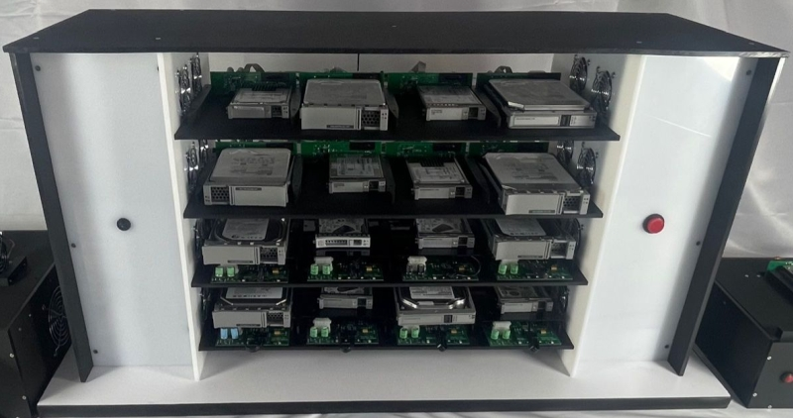
SAS 16 Port Long Test
Picture of SAS Long Test

